Slide 1
Lessons from Lithography for Elementary Art
Paige Byrne
Fall 2012
Notes:
This class in Lithography has improved my teaching in printmaking, by creating an environment during printmaking that builds independence and working together. This presentation shares examples of how the elements of Lithography can be experienced with young children in order for students to become more familiar with the actual process of Lithography.

Slide 2
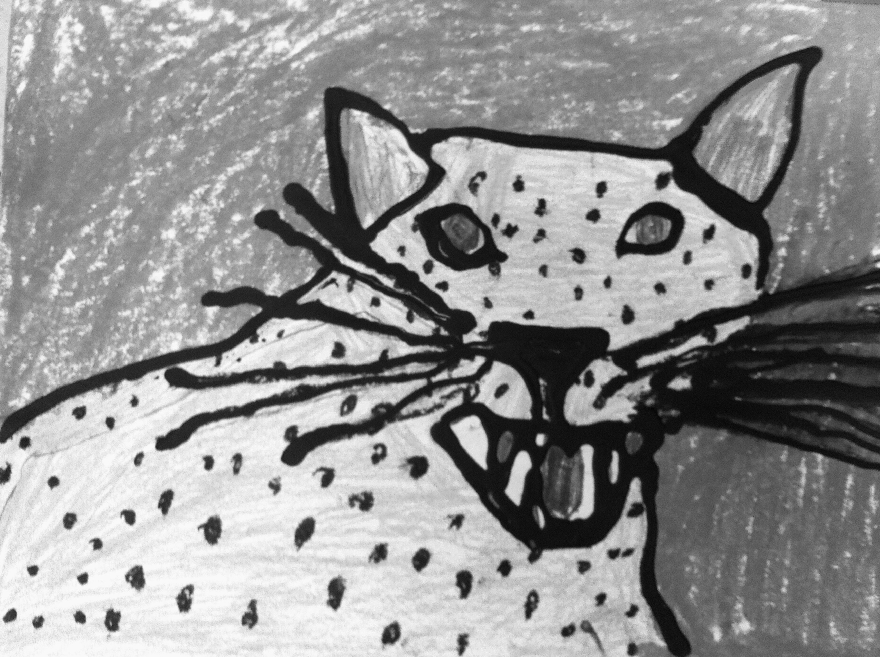
Could elements
of Lithography be brought to young people ?
Notes:
My essential question is “Could the elements of Lithography be brought to young people? I began to reflect on the Tuesday night class and selected 2nd grade, 4th and 5th grade as my test.

Slide 3
Discovered these 5 ways!
Yes!
Visual Aides improved Self Control Interdependence
Analogies from life used in printing process create a familiar Experience and creates peace with practice!
The process improves Self-Control
Printmaking develops a Community
Students experience Collaboration
Notes:
I discovered that yes, my experience as a student in Lithography was transferring in to my teaching and observations of student performance.

Slide 4
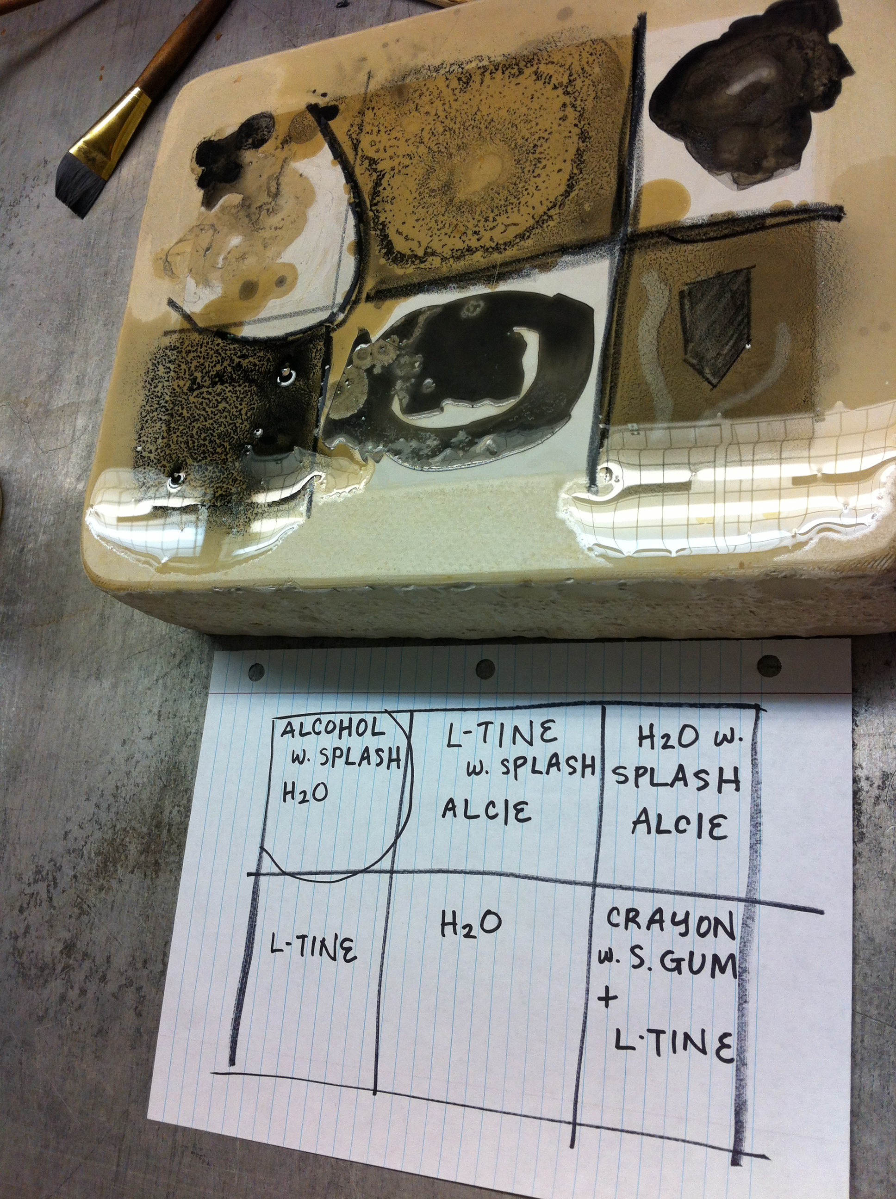
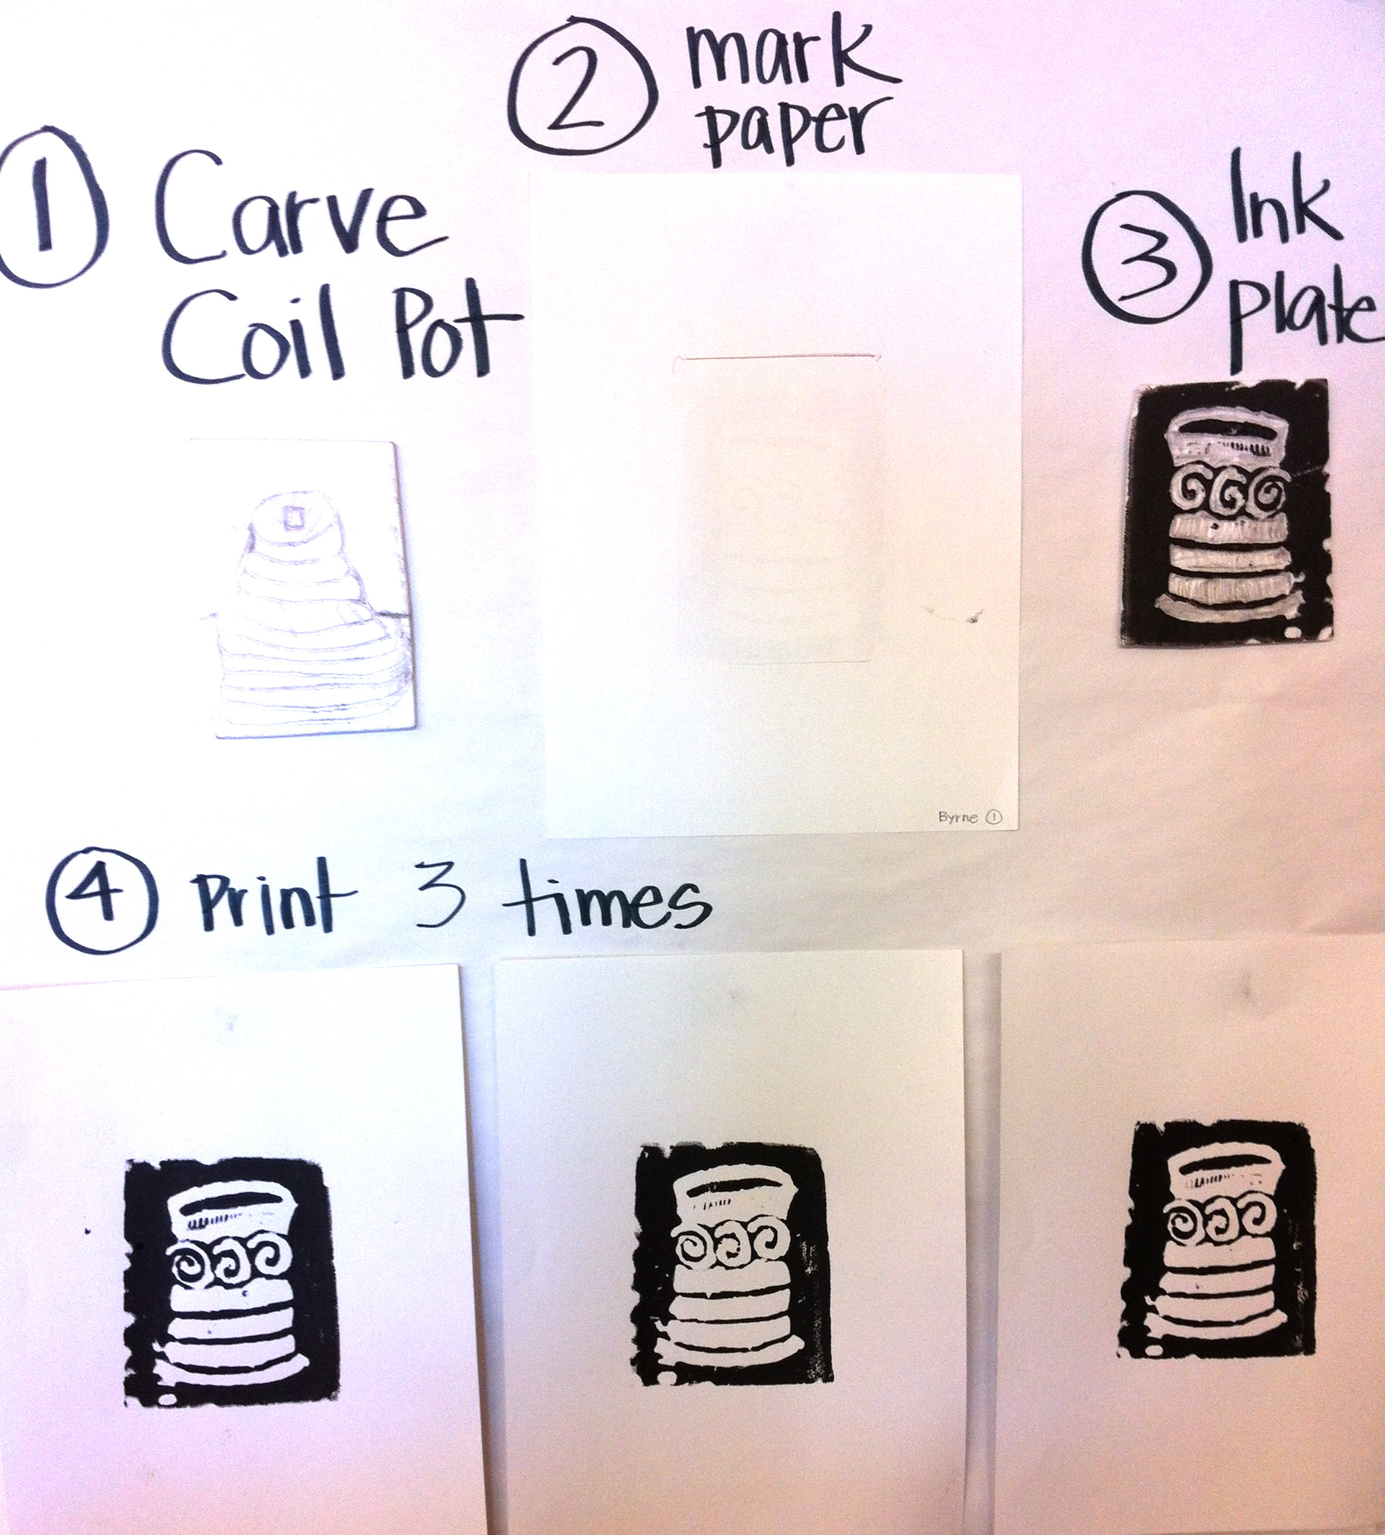
Visual Aides provide continuous support with each step
Clear & Simple!
Notes:
Visual Aids relax students so they are able to see what happens next. Even though much happens within these steps, the modeling and visual reminder supports them throughout the process. As a Lithography student, I realized how valuable visual aids are to experiencing the process and anticipating what will happen next. So, I created this simple and clear chart to post for 2nd grade students in printing Styrofoam plates. This created interdependence with each student as they moved through the process at their own pace.

Slide 5
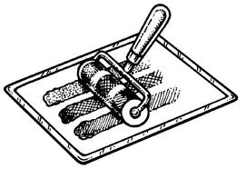
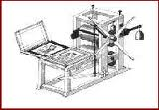
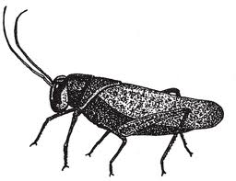
Analogies used in the process of preparing ink and printing plate improve students Self-Control
Students went from blobs on plexi to direct line application
Students roll ink until it sounds like a cricket and appears as smooth as an ice skating rink.
Notes:
In my demonstrations, the more analogies I used to compare the process to real life experiences, the greater the understanding. Lithography improved our application of ink onto the plate. These marks enhanced student self-control in using purposeful marks and adjusting amount of ink to plate.

Slide 6
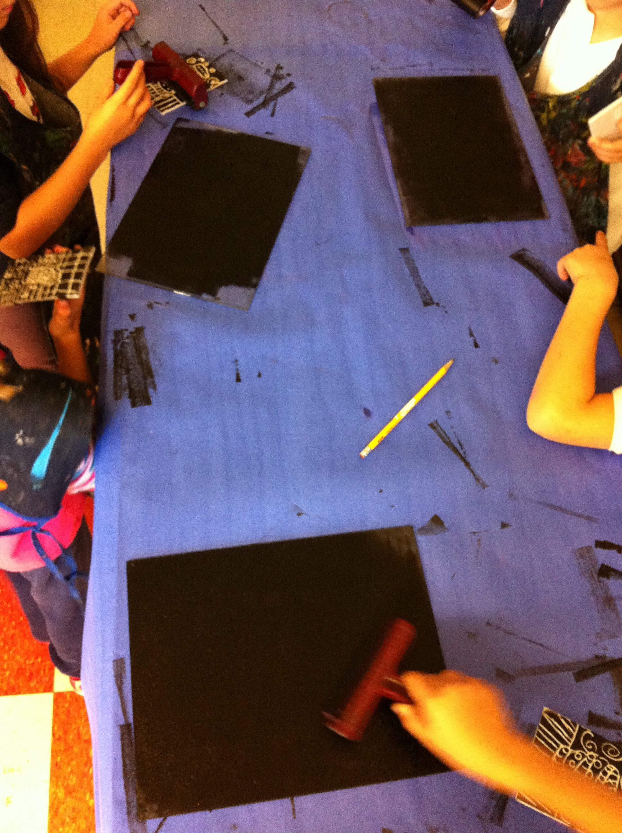
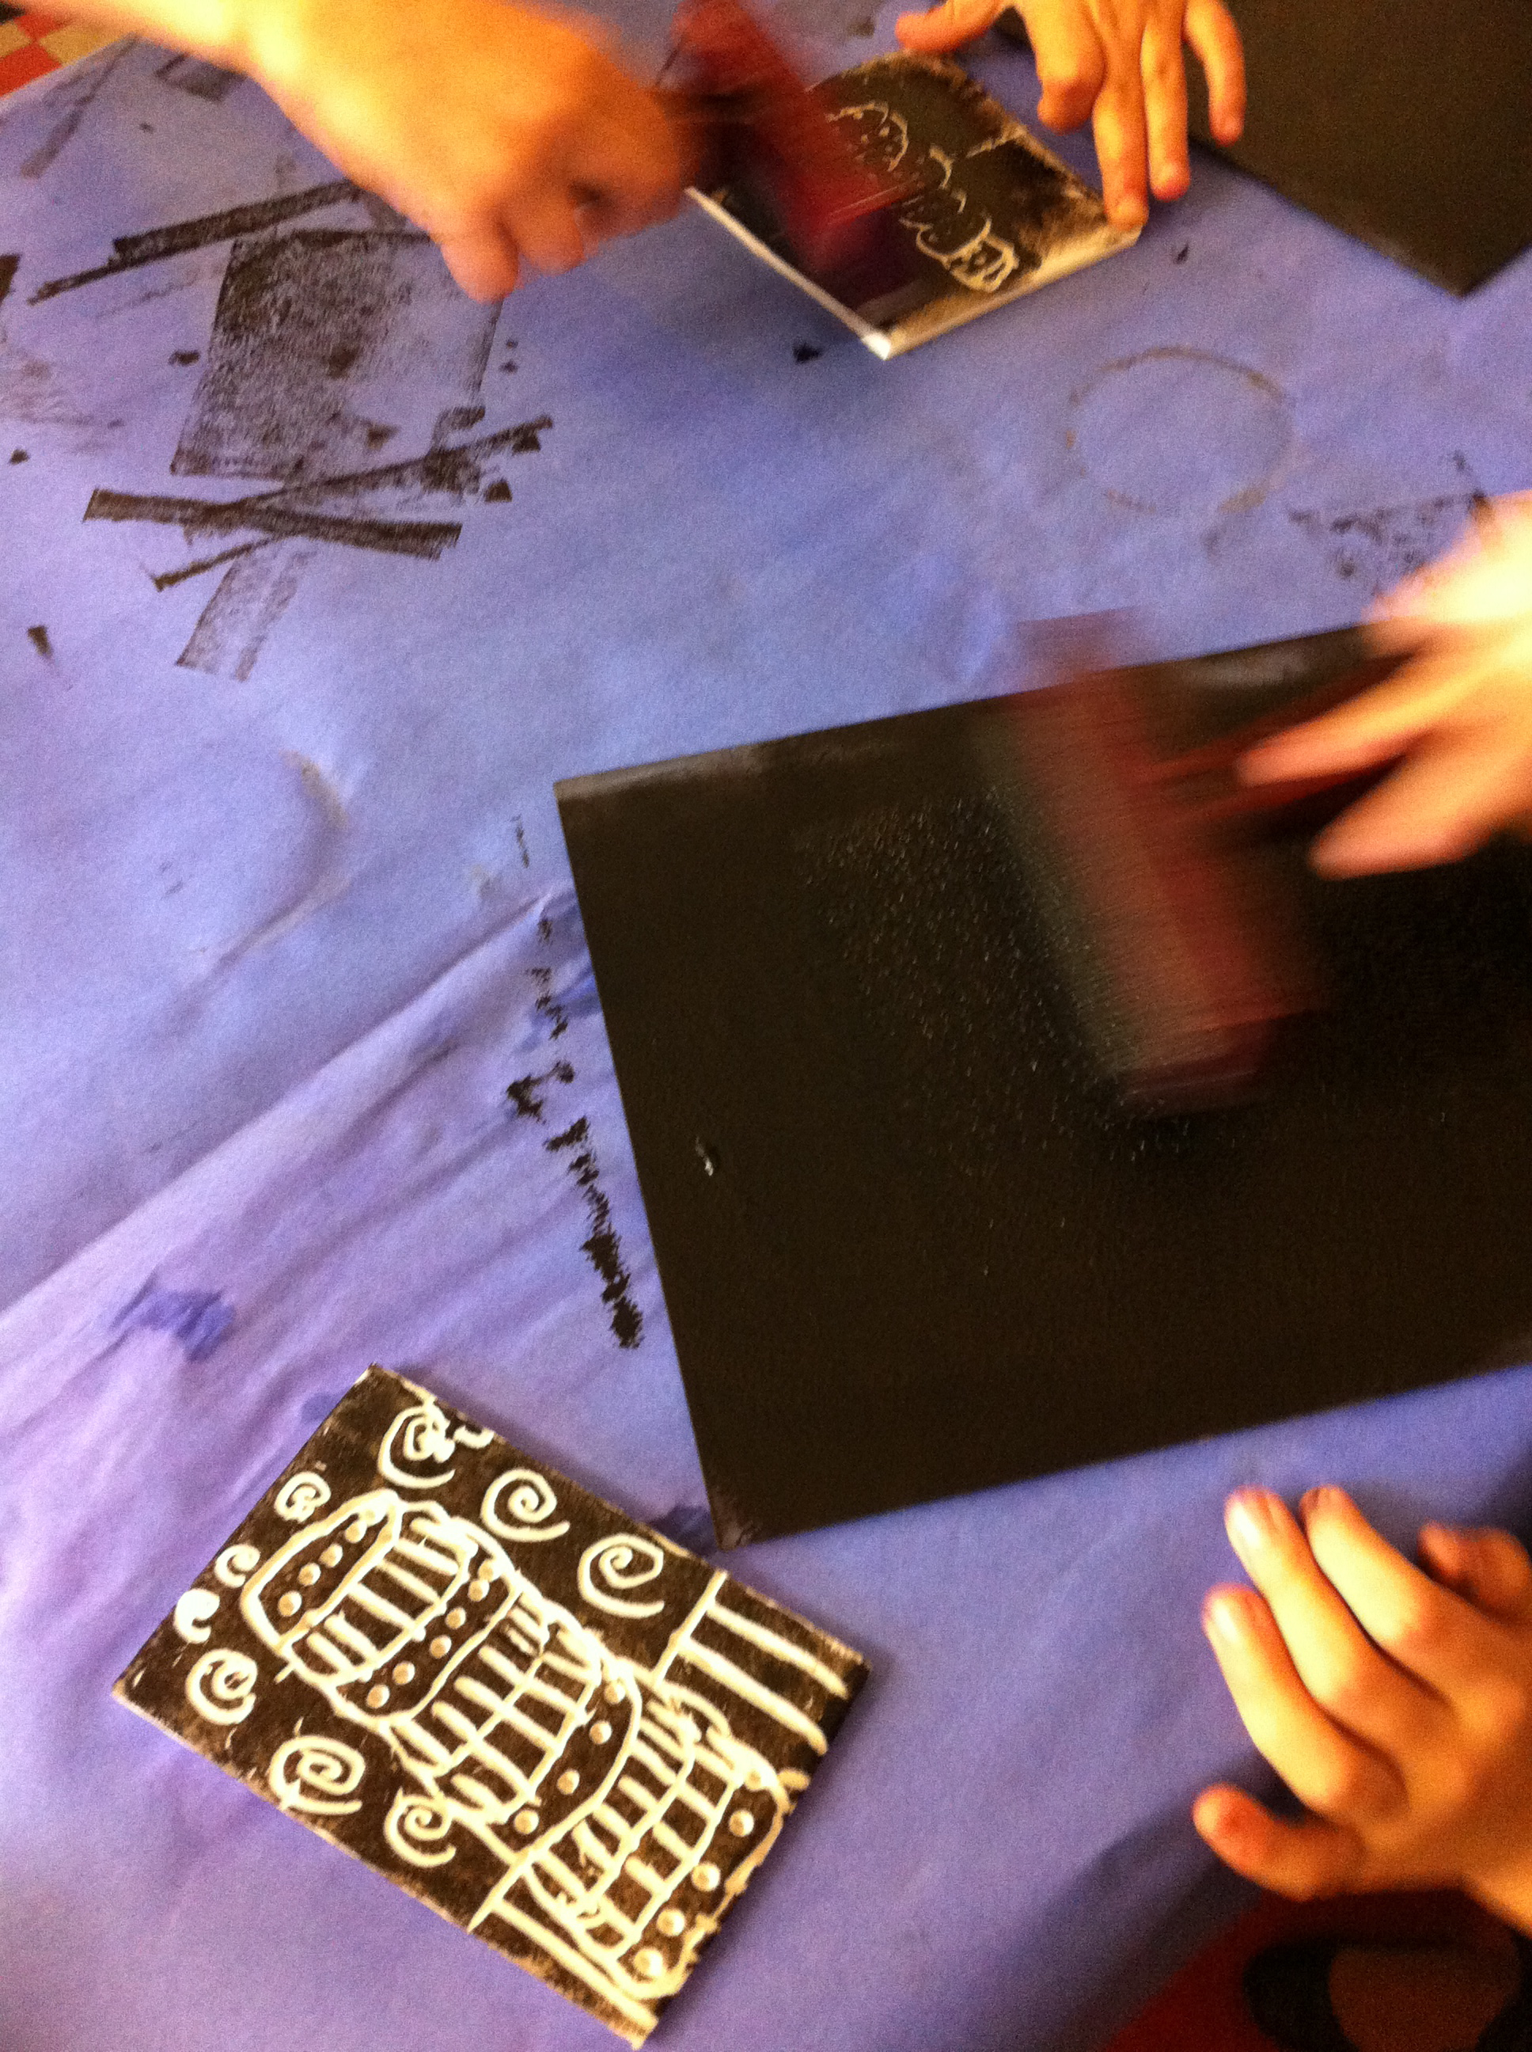
Printmaking offers the students an experience to develop a community that practices of sharing, process, respect for space and materials
There are 4 printing
plates per
12 students
Notes:
Establishing community by setting up a shared printing workspace. This was very helpful because my students, like myself as a student was able to keep track of the application of ink, how much ink to use, etc.

Slide 7
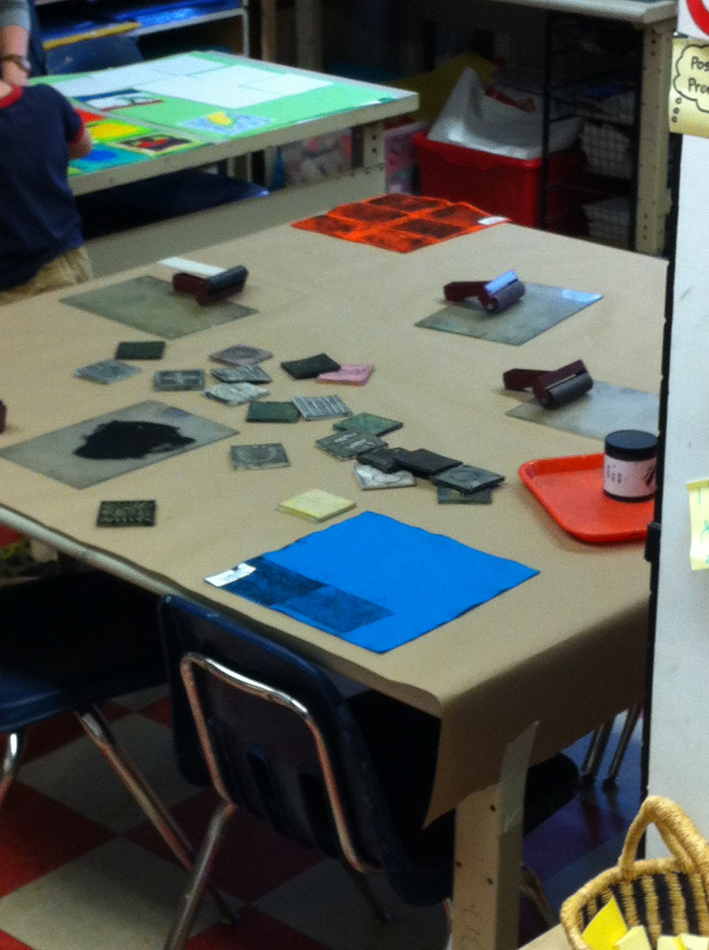
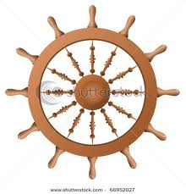
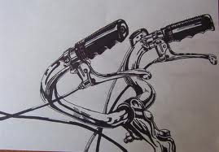
Students learn how to use self-control and become independent in application of pressure:
DIRECTLY GRADUALLY GENTLY CONSISTENTLY
Notes:
Here I’m pointing out the analogy of learning how to control the helm reminded me of adjusting the pressure of the press. With scooter, bikes and and perhaps even the computer self-control is extremely valuable to attain within many steps of printmaking.

Slide 8
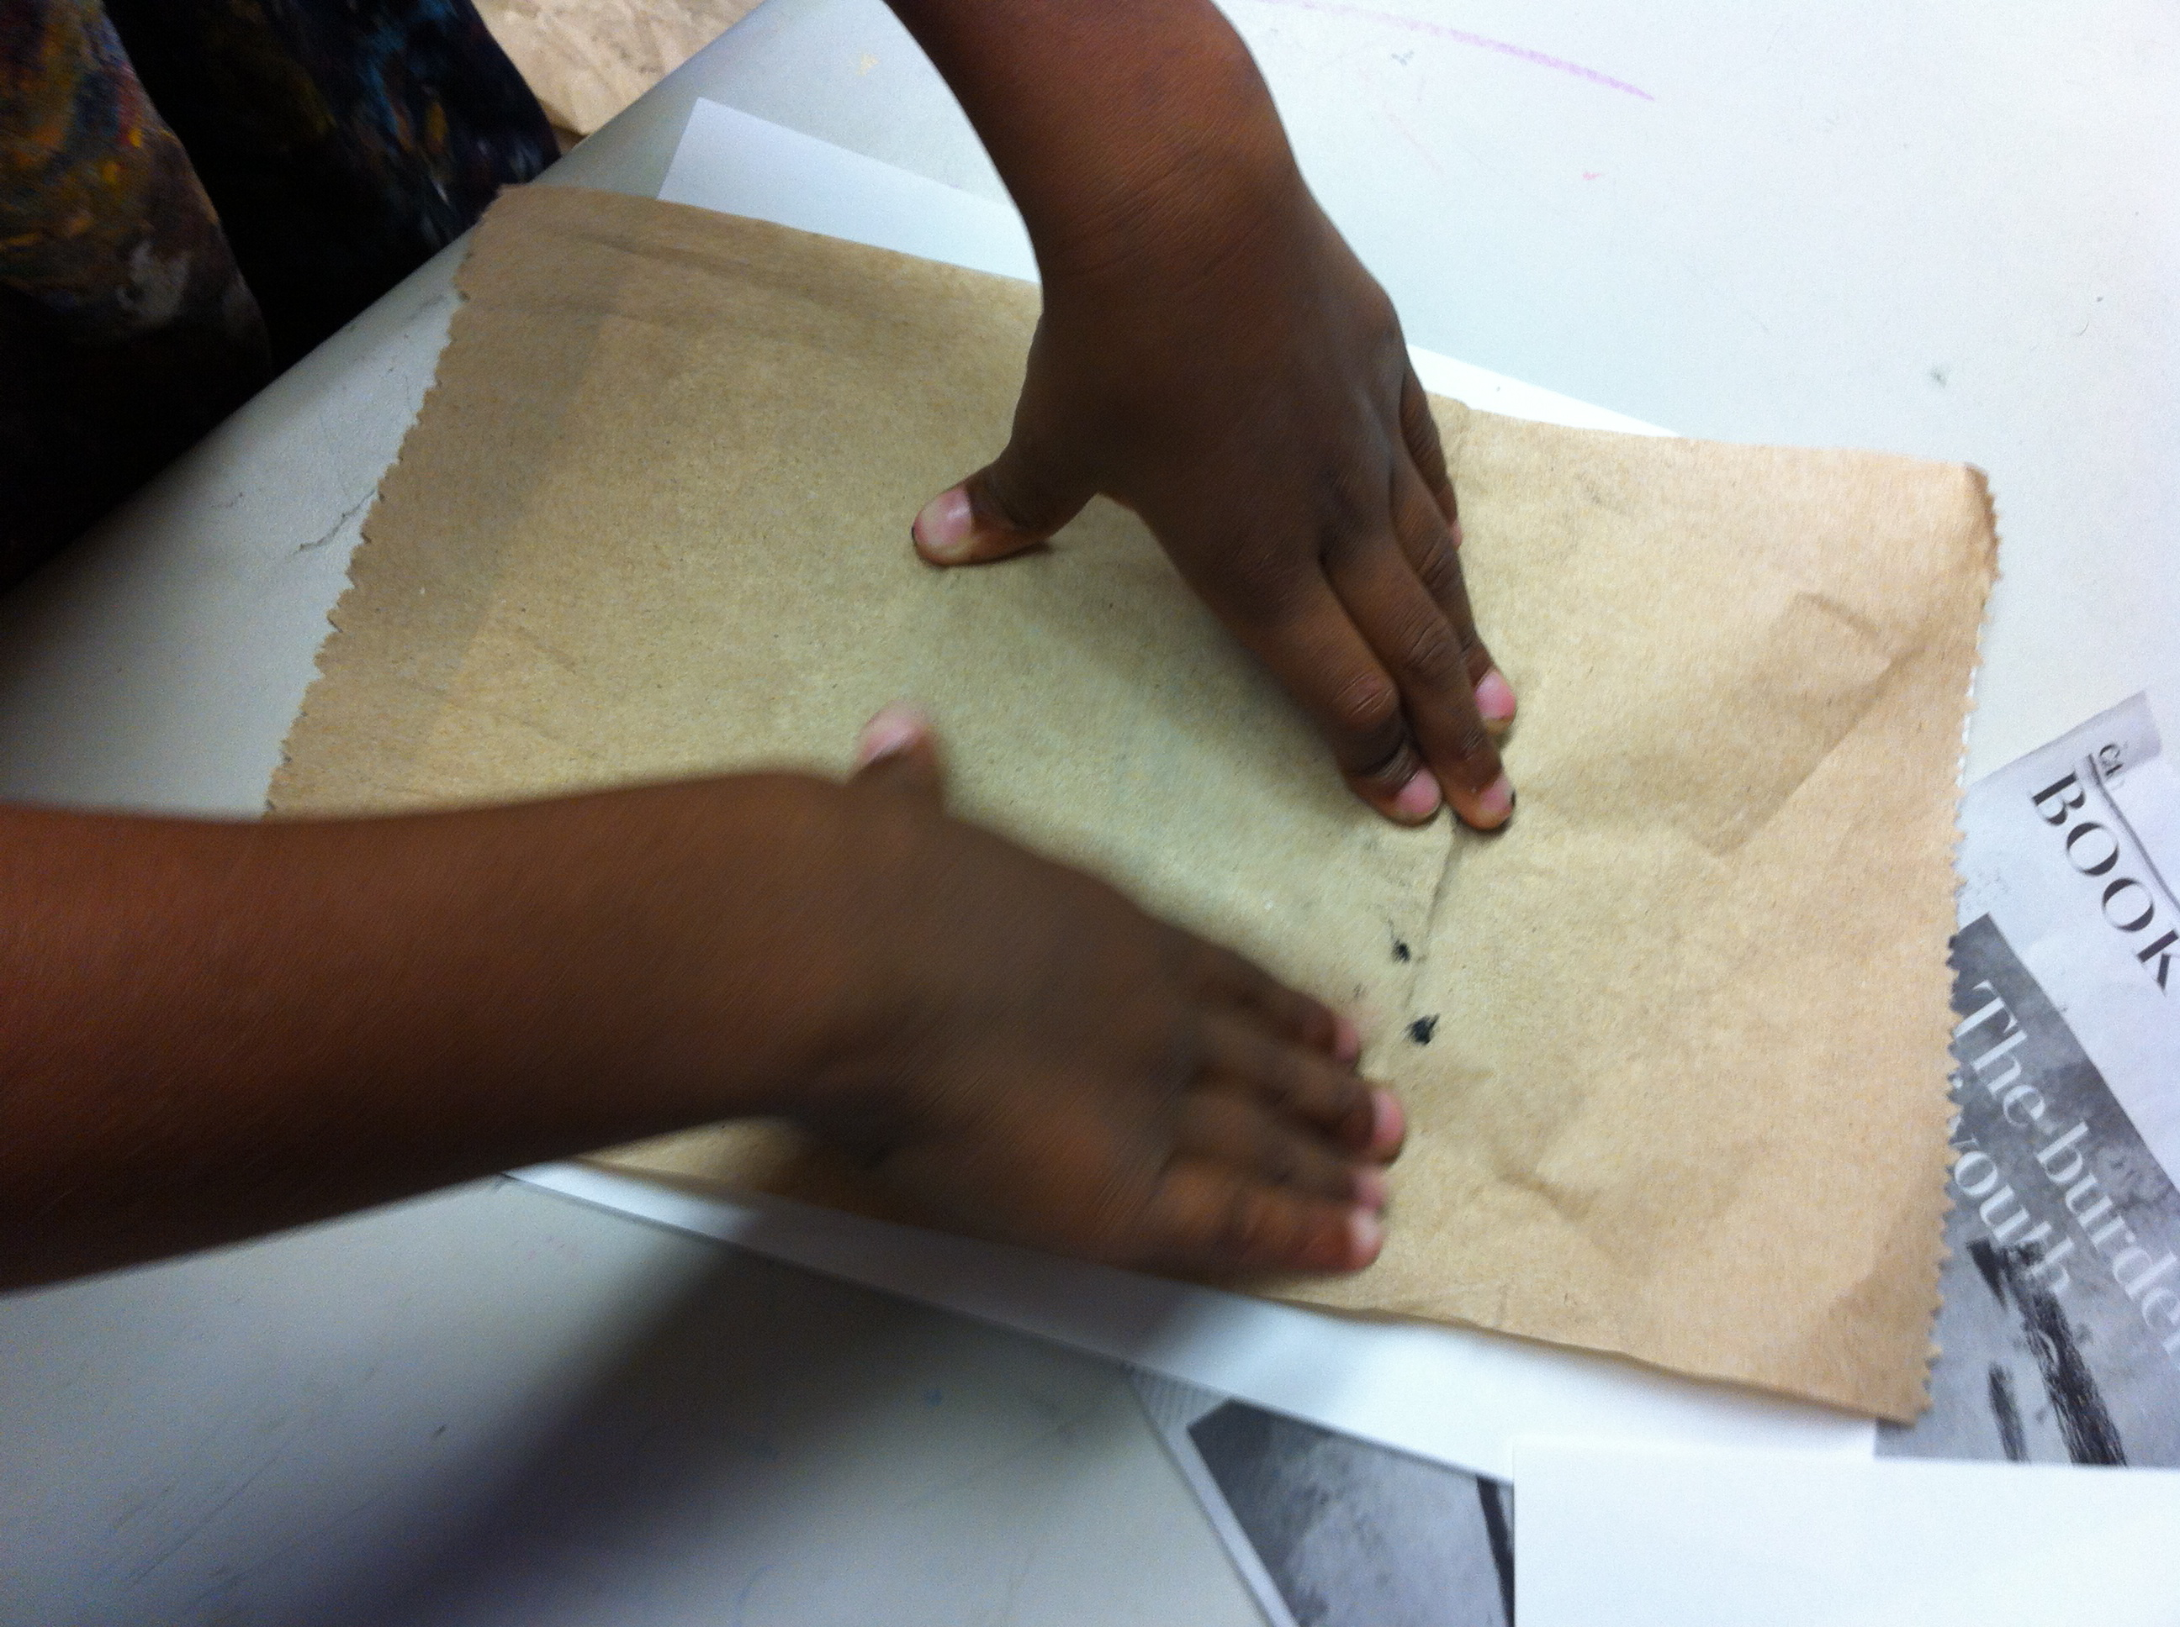
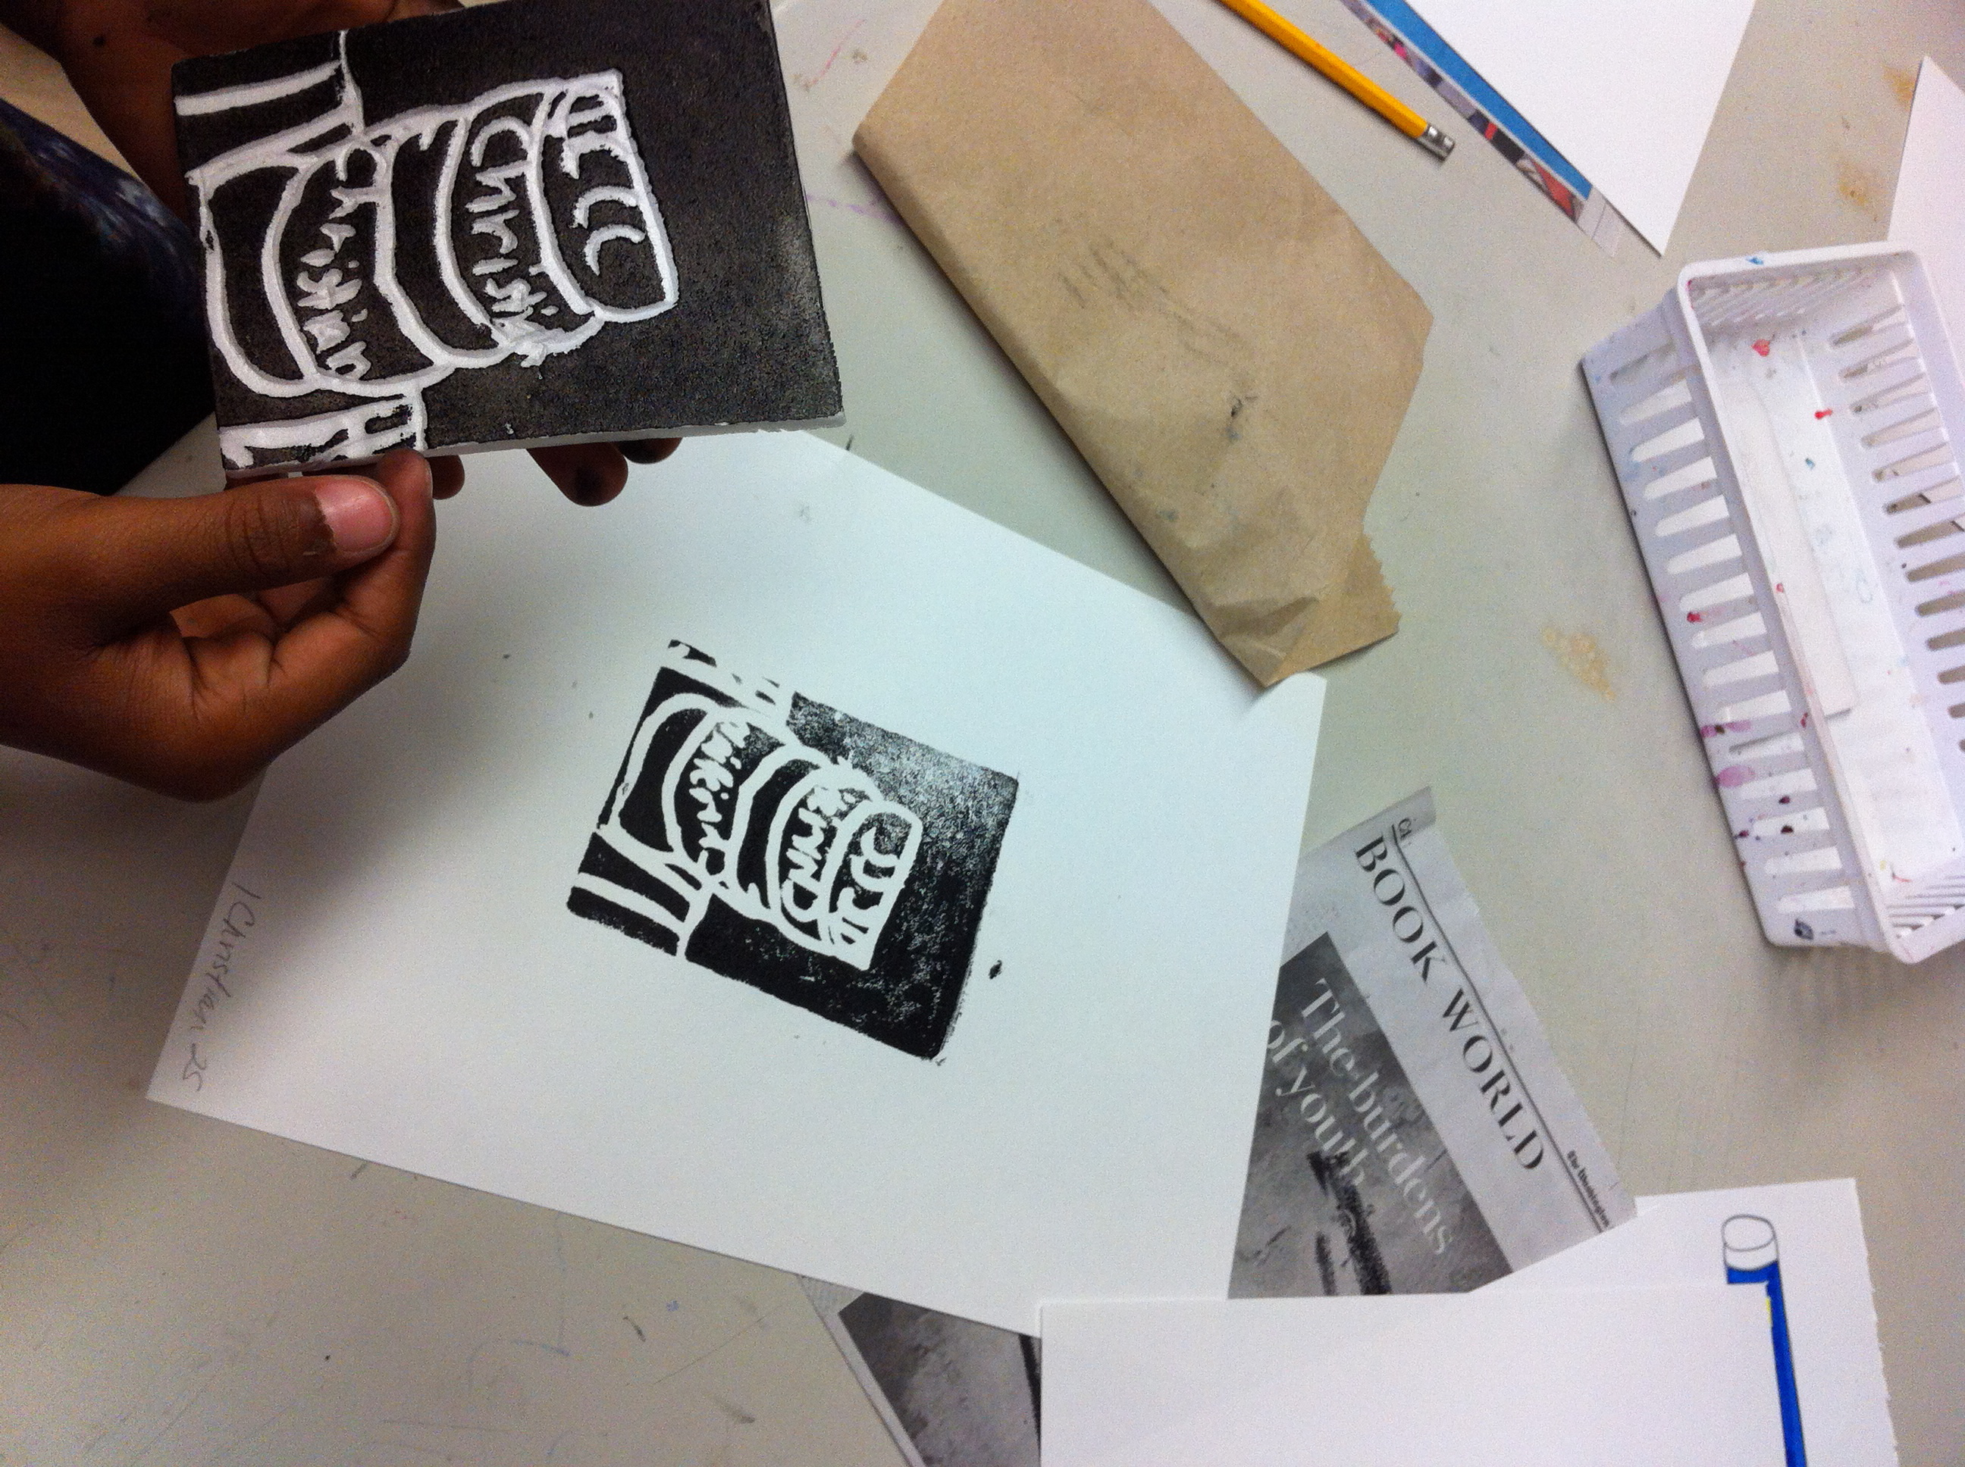
Practicing consistently clean prints. The use of paper towel assists students to keep clean borders! Lithography also polished up our paper prep process!
;, wit
Centering and Marking an Edition
Prior to printing , students mark 3
Papers with Styrofoam line @ top, center.
Then sign and number printing order
With 3 papers numbered.
Notes:
The excitement of printing any type of plate takes self-control. To assist with ‘landing the plate’ and keeping clean borders, we use paper towels and pre-marked paper to assist with centering. Numbering was so helpful with students understanding series and how the plate is the same, but there may be some variation…at this level!

Slide 9
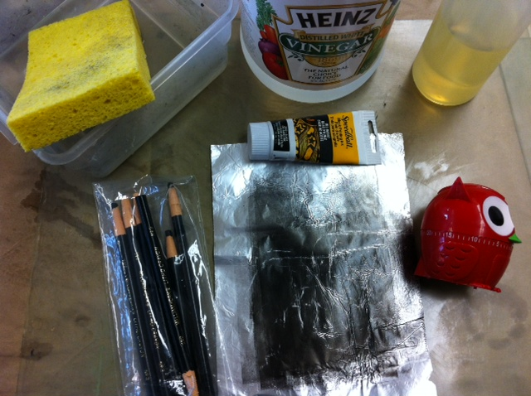
Lessons from Kitchen Lithography with the 5th grade!
Experiment First!
Notes:
We were not as successful as I would have liked to have been with the “Kitchen Lithography” found on You Tube. The materials were very tricky (too much or too little of any material or any procedure) to manage with students and took lots of practice. Because they had seen the video & of course wanted success, I figured out that students could at least experience the “reduction” process with straight up water based printing ink and mono prints with foil. I know our 1975 sink will be so happy!!

Slide 10
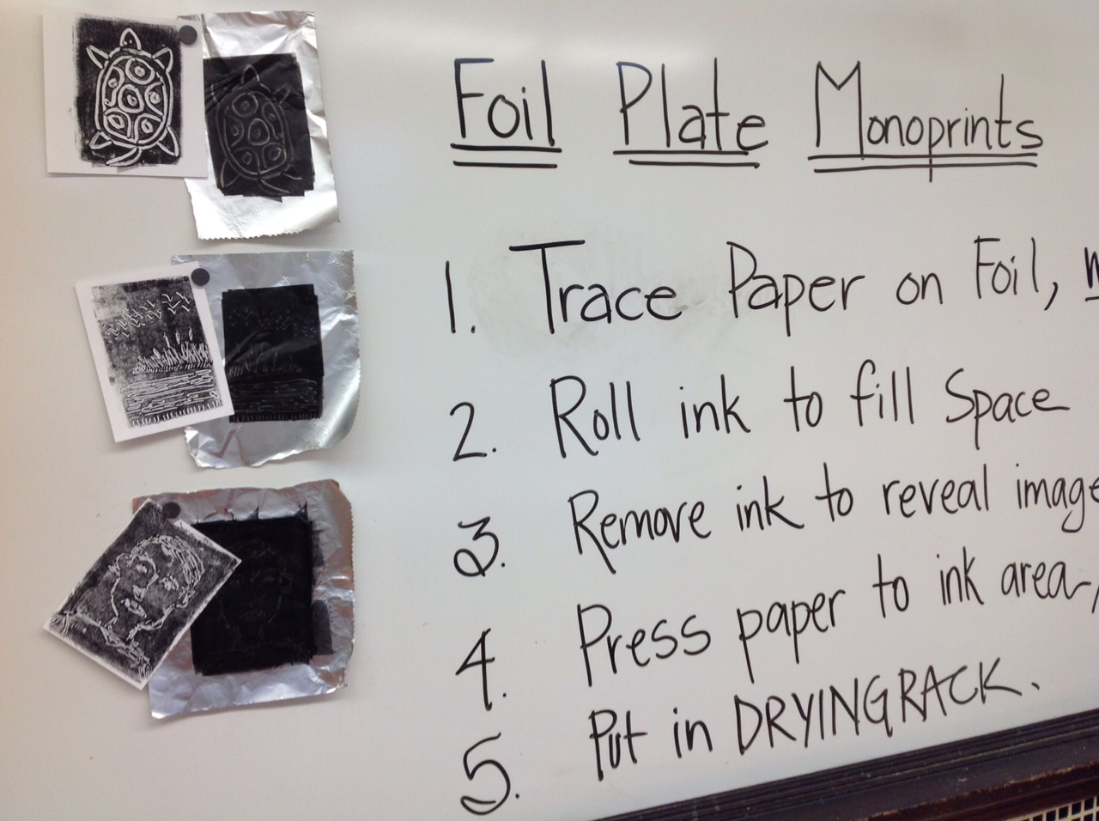
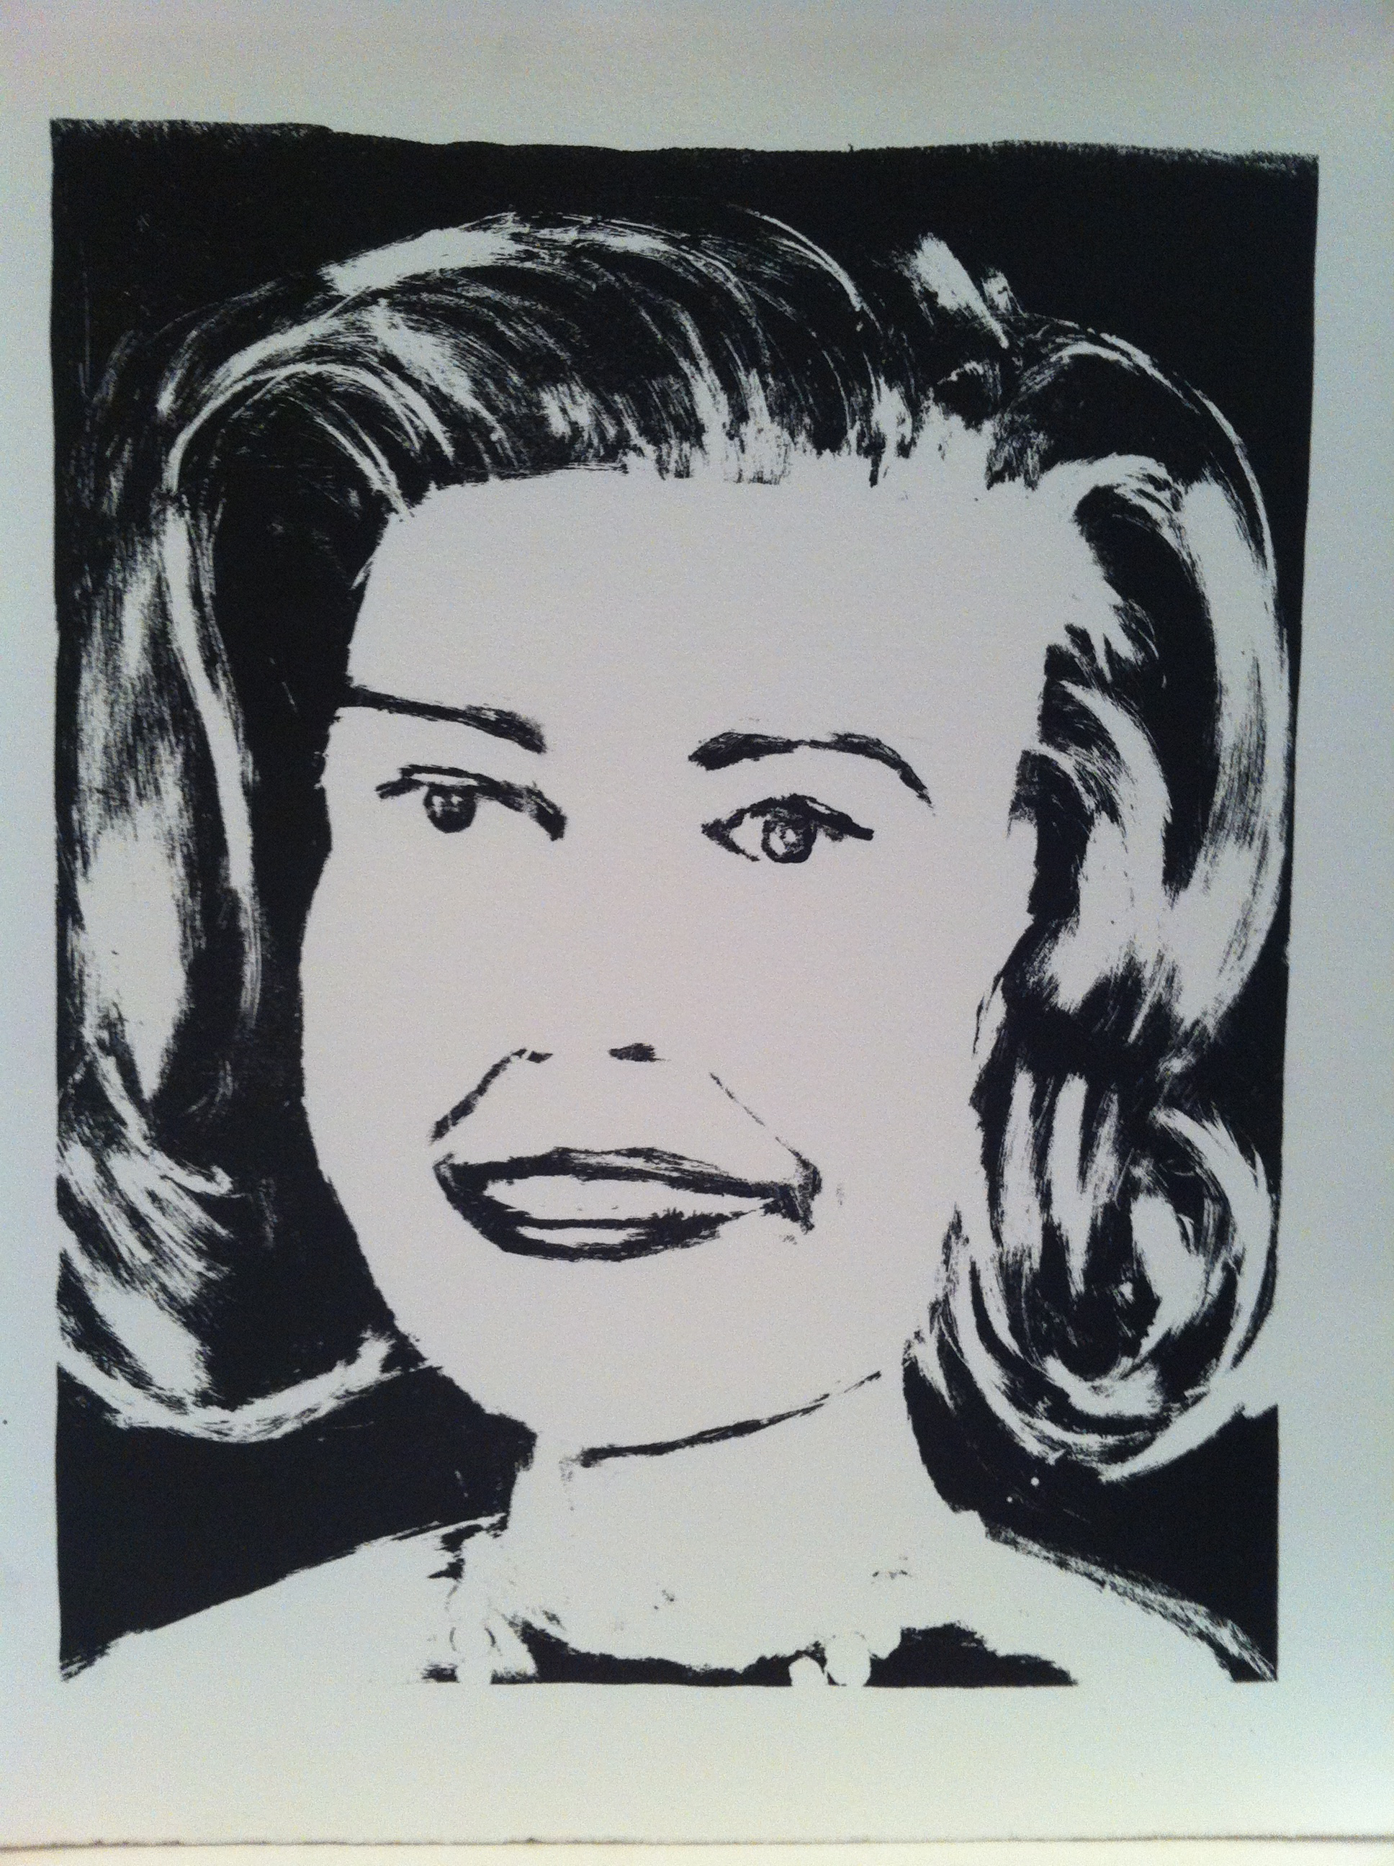
Edit, simplify and revise to keep your learners tuned in!
I II
I Owe
You!
Notes:
My 5th graders watched the private you tube video, copyrights of his video would not allow me to share here, but he is very responsive to comments and sent a pdf of directions! We tried and tried, maybe too much oil left, but it was time to move on. In Lithography, the reduction process was my ticket to maintaining the student enthusiasm!! “I owe you” is the reduction assignment I did of my mother for Lithography.

Slide 11
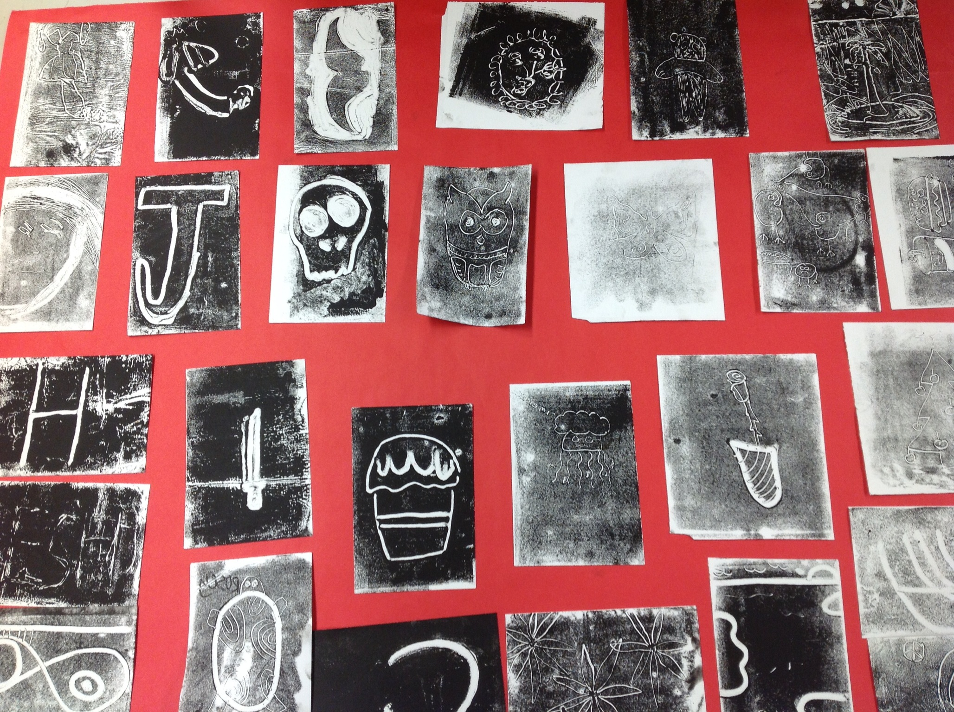
“bon a tirer”
At last we were….
Notes:
We will move forward from foil prints to linoleum prints. I highly recommend the vimeo video “Bon A Tirer” easy to find online.

Slide 12
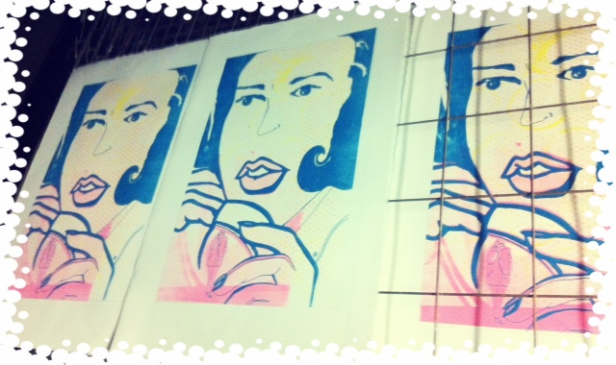
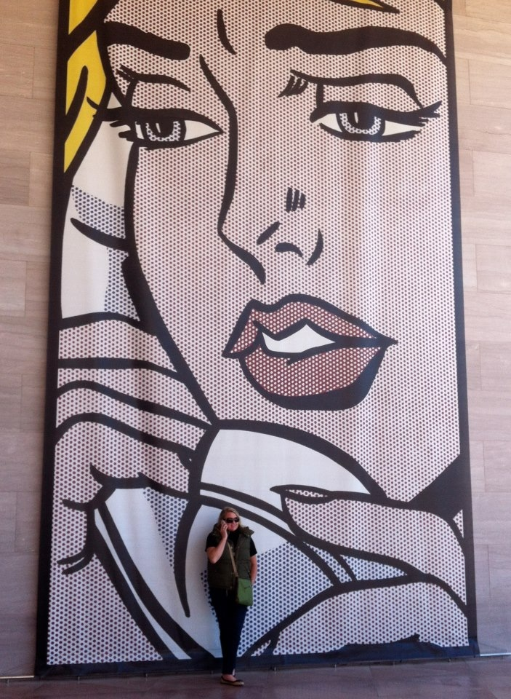
The Lichtenstein Retrospective inspired so much:
How he found his own style
The way he paid homage to artists he admired
His use of color, line and space to convey a message
“Calling Mom” photo plate assignment using litho image of mom
Notes:
Lichtenstein’s Retrospective blew my mind and inspired my thinking so much in terms of color and layering. I was thinking, thinking, thinking of what to use with students. H

Slide 13
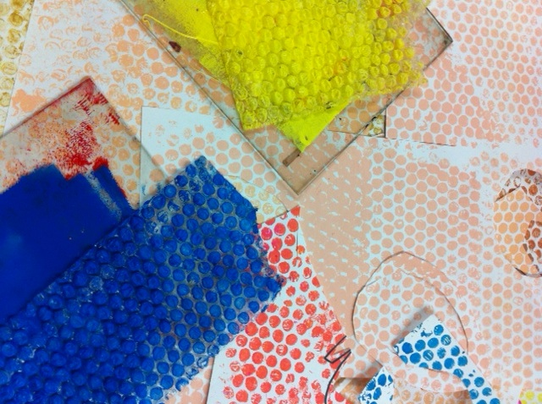
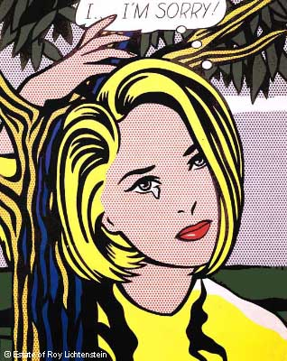
Notes:
Bubble wrap finally popped in my mind and would serve as an excellent tool for Lichtenstein’s Ben-day pattern. I also learned from exhibit that Lichtenstein became frustrated with his work and not finding success as an abstract expressionist. Studying his “Lichtensteined” artworks of his peers, such as Matisse and Picasso, students were able to understand the influences and inspirations artists share in their own work.

Slide 14
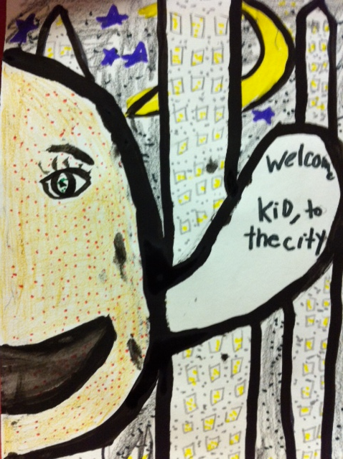
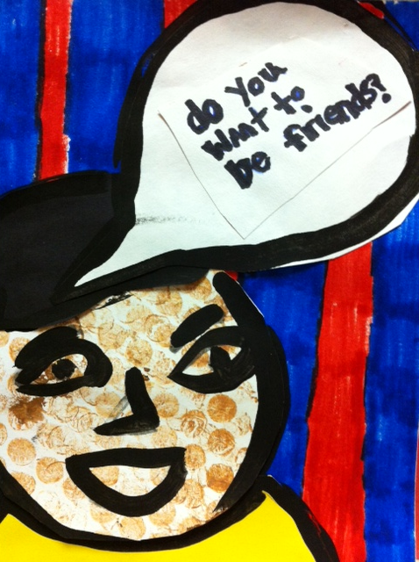
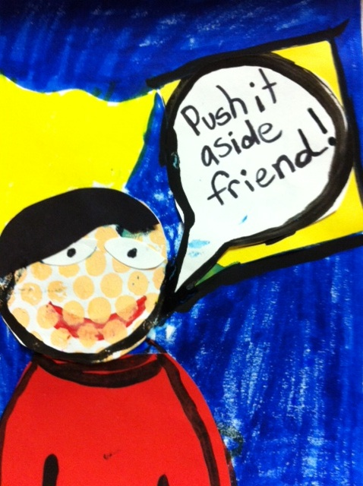
“Art sends a message:
Kindness 2013”
Notes:
These examples are some of the first produced by Fourth grade as we focus on Kindness in 2013.

